Slide 1
Value Delivery Model

Slide 2
Outline
Current Process
Future Process
Paradigm Shift
Introduce the Value Delivery Model
Overview of the Pre-Concept Phase Gate
Goals for the Pre-Concept Phase
Unleashing Innovation
Building a Business Case
Next Steps
Strategyn Overview

Slide 3
Current Delivery Model
Customer value is difficult to capture. It typically include high level needs, as is issues and to be analysis with inconsistent capture of product features
Business case is built using hard metrics around cost reduction and cycle time reduction
Customer needs and features are recorded in documents using inconsistent grammar.
Projects are based on silos of customer needs w/ little opportunity to align & address common sets of customer needs across projects using a single solution

Slide 4
Future Delivery Model
Customer needs are captured using a disciplined methodology and value can be accurately measured
Customer outcomes are captured in a repository where they can be rationalized and prioritized
Business case can be built using hard metrics covering value and cost
Customer needs and features are recorded in a repository using a consistent grammar, where they can rationalized and prioritized
Projects are based on prioritized opportunities across common sets of customer needs and addressed using a single solution

Slide 5
Paradigm Shift…
From: focusing on (product) Features
To: focusing on (customer) Outcomes

Slide 6
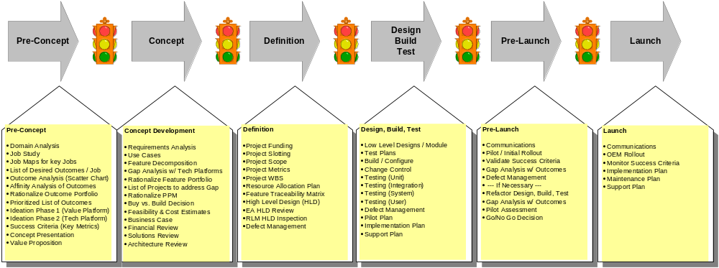
Value Delivery Process
A new approach for understanding what customers want…
Aligning portfolios of assets across the change management platform…

Slide 7
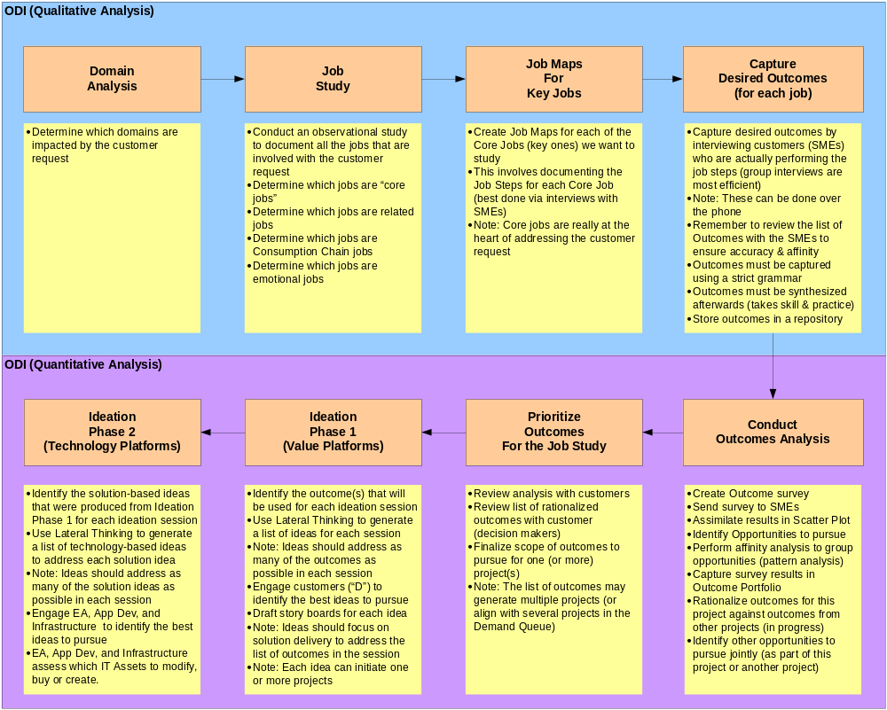
Overview of Pre-Concept…

Slide 8
Goals for Pre-Concept Stage
Understand customer needs from a “job” perspective and capture their desired outcomes
Understand level of satisfaction with outcomes – Defines unmet / under met needs and opportunity for value creation
Focus Ideation on value delivery (first), then on technology delivery (second) to create solutions that address the value creation opportunities

Slide 9
Unleashing Innovation
Introduction of a two-level ideation process
  Level 1 involves ideation around the Value Platforms
    This is where we extend existing solutions or create new ones to address the prioritized list of customer outcomes
    Marketing, R&D, Business Stakeholders, Business SMEs
  Level 2 involves ideation around the Technical Platforms
    This is where we extend existing technologies or buy new ones (buy vs. build)
    Marketing, R&D, Technical Specialists (internal / external)

Slide 10
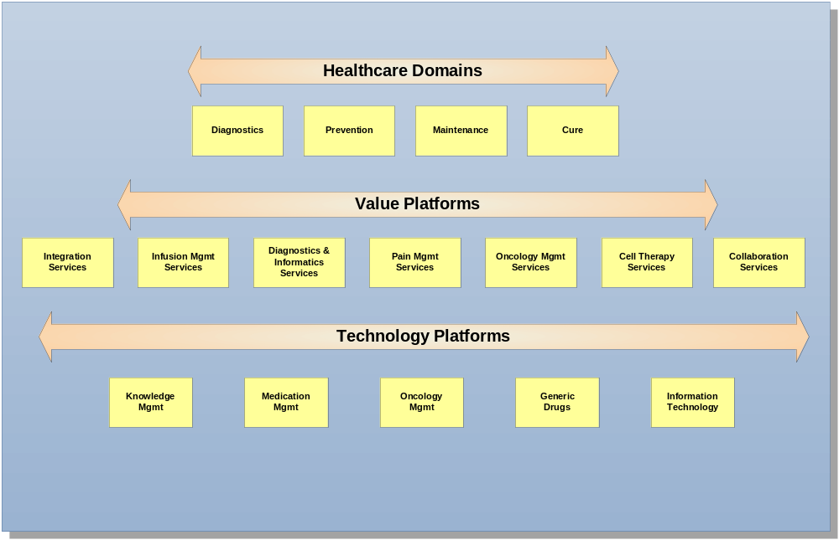
Tiered Platform Model

Slide 11
Building a better Business Case
Business has a clear understanding of the opportunities we can provide for the customer
The customer has a list of prioritized outcomes for which they can measure value
Business is now able to focus disciplined ideation into the development lifecycle
The Pre-Concept phase gate bridges the business silos to enable collaboration as part of concept definition
The Concept phase gate provides the feature decomposition required for more accurate estimates for products/services delivery

Slide 12
Next Steps
Socialize the new Development Lifecycle Model amongst the HRPC members
Gain approval from HPRC to include the Pre-Concept phase
Socialize the new model amongst the HPRC Teams
Gain approval from the Leadership to pilot the new model
Select a non-critical project for the pilot
Gain final approval on pilot project
Conduct the pilot
Capture feedback from the team
Review pilot results
Provide training for the appropriate HPRC participants
Expand the use of the model to other projects

Slide 13
Strategyn Overview

Slide 14
Strategyn Client List
Health Care
Kimberly Clark
Johnson & Johnson
Guidant
Medtronic
Harvard Kennedy School of Government Healthcare Study
California Health Care Foundation
Coloplast
Becton Dickenson
B.Braun
AMO
Deltec
Dentsply
Hollister
Financial Services
Morgan Stanley
Met Life
State Farm
AIG Financial Services
AXA
Washington Mutual
H&R Block
Toronto Dominion Bank
Assurant
Pershing
Manufacturing
3M
Ecolab
Bosch
Ingersoll Rand
Neenah Paper
Line 6
John Deere
Masco
Rohm & Haas
MeadWestvaco
Consumer Products
Colgate
Unilever
Chiquita
Hallmark
Hill’s Pet Nutrition
Cargill
Simplot
Mead Johnson Nutritionals
Technology
Microsoft RIM
Hewlett-Packard Nortel Networks
IBM Reynolds & Reynolds
Motorola Ceridian
Intuit
Attenex
Vtech
Plantronics

Slide 15
Assess Your Organization …
 | Is there agreement among managers in your company as to … | YES | NO
1 | What innovation is? |  | √
2 | What a customer need is? |  | √
3 | How to determine which customer needs are unmet? |  | √
Notes:
As it turns out, none of these beliefs are true. Today we are going to show you how to reinvent the innovation process.

Slide 16
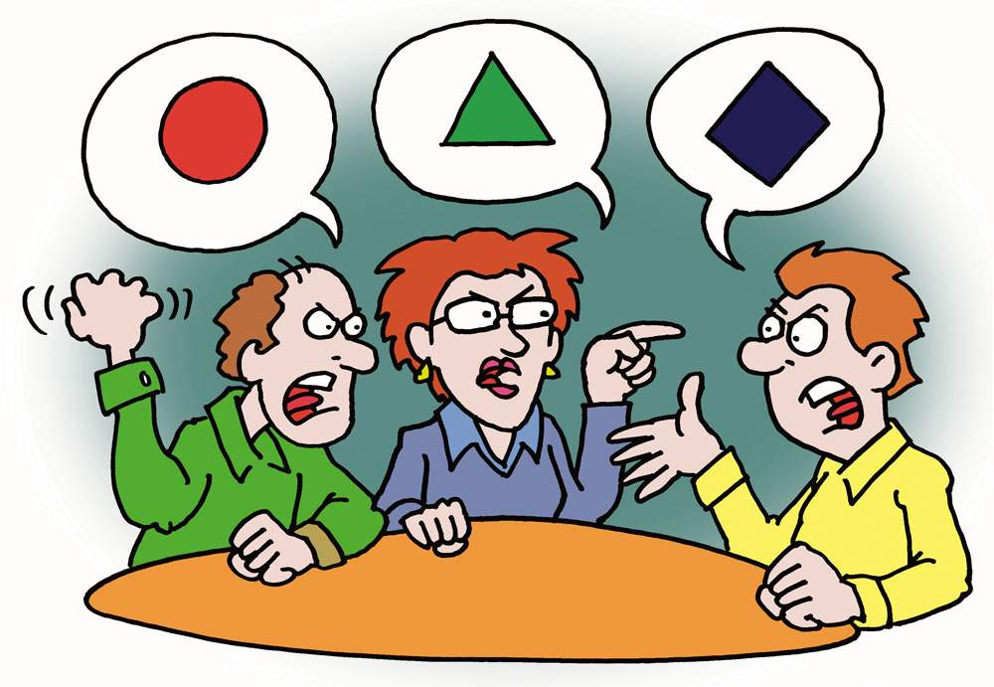
The Sought After Input Has Not Been Defined
Everyone talks about customer “needs”, but there is no agreement on what a need is – what its purpose, structure, content and format should be
Without a basis for agreement, frustration abounds
R&D
Sales
Marketing
Strategyn Cartoon - 2006
“You have to listen to me …
I know exactly what customers want!”
Notes:
Companies have been talking about satisfying customer needs for so many years – at least since the 1950s. Yet to this date there is no agreement as to what a need is – that is what its purpose, structure, content and format should be.
h
Without this agreement, conflict between marketing, development and sales continues.

Slide 17
Hierarchy of Customer Inputs
Core Functional Job
Other Functional Jobs
Emotional Jobs
Consumption
Chain Jobs
Purchase
Receive
Install
Set-up
Learn to Use
Interface
Transport
Store
Maintain
Upgrade
Replace
Dispose
Jobs Indirectly Related to Core Job
Jobs Directly Related to Core Job
Personal Jobs
Social Jobs
Job Map
Process
Step 1
Process
Step 2
Process
Step 3
Outcome 41
Outcome 42
Outcome 43
Outcome 44
Outcome 45
Outcome 1
Outcome 2
Outcome 3
Outcome 4
Outcome 6
Process
Step 5
Process
Step 4
Desired outcomes are the metrics customers use to measure the successful execution of a job.
Create
solution
Support
solution

Slide 18
The Job is the Primary Unit of Analysis
Products come and go – the job is the stable, long-term focal point around which value creation must be centered
The job’s perfect execution reflects the customer’s true definition of value
Requirements are not captured on the product – they are captured on the job the product or service is intended to perform
Desired Outcomes on the Job of Storing-Retrieving Music | Satisfaction
 | Vinyl | CD | MP3
Increase the number of songs available for selection | 4 | 5 | 8
Minimize the likelihood that the music is distorted | 5 | 8 | 9
Minimize the likelihood of damage during normal use | 3 | 6 | 9
Minimize the amount of storage space that is needed | 4 | 6 | 9
Increase the degree to which the music sounds live | 5 | 7 | 6
Cumulative Satisfaction | 42% | 64% | 82%

Slide 19
This is a Customer Need (Desired Outcome)
Direction of
Improvement
Unit of Measure
Object of Control
Minimize … the time it takes … to verify the accuracy of a desired outcome
with a customer, … e.g., its meaning, completeness, exactness, etc.
Contextual Clarifier
Example of Object of Control
The statement’s structure, content and format limit variability
The statement prompts a course of action
It is not open to interpretation
Does not confound the way it or other statements are prioritized

Slide 20
When Is a Need Unmet?
If a desired outcome is both important and unsatisfied, it is unmet
The more important and less satisfied an outcome is (the more unmet it is) the greater it represents an opportunity for value creation
Outcomes are prioritized based on their attractiveness as opportunities for value creation

Slide 21
How Do We Identify-Prioritize Opportunities?
Administer a survey (web, phone) to a significant population
Determine the importance of each outcome
Determine the degree to which each is satisfied, given the solution(s) they are using today
Use the Opportunity Algorithm to identify opportunities
How important is it that you are able to….? | Not Important At All | Somewhat Important | Important | Very Important | Extremely Important
Increase the percent of plants that emerge at the same time | ₁ | ₂ | ₃ | ₄ | ₅
Minimize the time it takes the plant to absorb nutrients once they are planted | ₁ | ₂ | ₃ | ₄ | ₅
How satisfied are you with your ability to….? | Not Satisfied At All | Somewhat Satisfied | Satisfied | Very Satisfied | Extremely Satisfied
Increase the percent of plants that emerge at the same time | ₁ | ₂ | ₃ | ₄ | ₅
Minimize the time it takes the plant to absorb nutrients once they are planted | ₁ | ₂ | ₃ | ₄ | ₅

Slide 22
What is the Opportunity Algorithm?
If 90% of the respondents rate an outcome a 4 or 5 for importance, the Importance value entered into the algorithm is a 9.0.
If 30% of the respondents rate an outcome a 4 or a 5 for satisfaction, the Satisfaction value entered into the algorithm is a 3.0
OUTCOME | IMP | SAT | OPP
Minimize the time it takes to for the plant to come out of the ground | 9.0 | 3.0 | 15.0
Increase the percent of plants that emerge at the same time | 8.5 | 3.5 | 13.5
Increase the percent of needed nutrients that are absorbed by the plant | 8.0 | 5.0 | 11.0
Minimize the time it takes the corn to turn green, e.g., produce chlorophyll | 7.5 | 6.5 | 8.5
Opportunity = Importance + max (Importance – Satisfaction, 0)

Slide 23
Visualizing the Opportunity Landscape
10
Opportunity = Importance + max (Importance – Satisfaction, 0)
9
Over-Served
Sustaining or
Breakthrough
Innovation
8
Table Stakes
Limited
Opportunity
7
Ripe for
Disruption
Opp >10
Solid Opportunity
6
Satisfaction
5
Opp >12
High Opportunity
4
Potential for
Disruption
3
2
Opp >15
Extreme
Opportunity
1
Appropriately Served
Under-Served
1
2
3
4
5
6
7
8
9
10
Importance

Slide 24

Focused Idea Generation Replaces Brainstorming
Companies do not have to brainstorm hundreds of ideas and hope that one of them is a breakthrough idea
People know and agree on what needs are unmet
With a focus on specific unmet needs (desired outcomes), individuals are able to generate ideas they know in advance will be worthy of investment
Outcome-focused idea generation replaces scattershot brainstorming and systematizes the concept creation process
The dynamics of innovation are changed

Slide 25
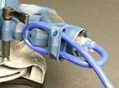
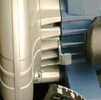
Creating the Bosch CS20 Circular Saw
OUTCOME | OPP
Minimize the cost of repairs due to cut cords | 11.5
Minimize the likelihood of snagging the cord on the material | 12.7
Minimize the likelihood of dropping the saw when lower it | 10.5
Direct Connect; removed the cord
OUTCOME | OPP
Minimize the amount of debris that is thrown up into the users face | 11.4
Minimize the likelihood of inadvertently moving off the cut line/path | 13.5
Blower is aimed down and at the cut line to blow debris away and provide line of sight

Slide 26
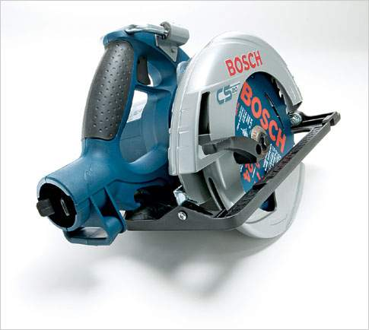
The Bosch CS20 Circular Saw
“Strategyn’s outcome-driven approach to innovation made it possible for us to hit a home run in the mature and competitive circular saw market.”
Bosch CS20 Product Manager
Jason Schickerling

